Slide 1
ECE 542 Project Proposal Control mass-spring damper with Arduino
Mass Spring Damper Setup on 3rd floor in the senior capstone room has a few problems
Older computer
No Network connection
Proprietary parallel interface leaves little room for PC upgrade
Arduino could connect to existing hardware interface (motor/encoder) to bypass proprietary electronics box
Familiar Arduino programming interface for students
USB connection works with modern computers

Slide 2
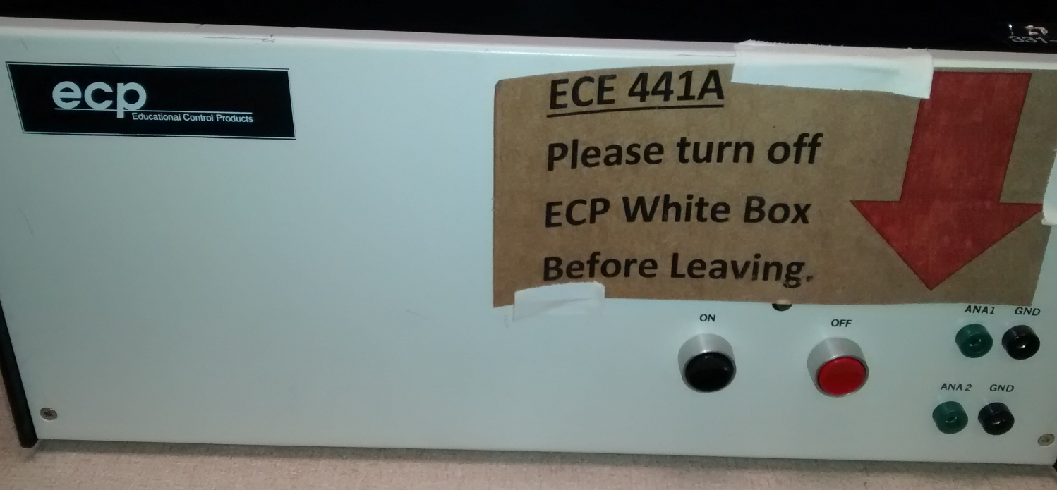
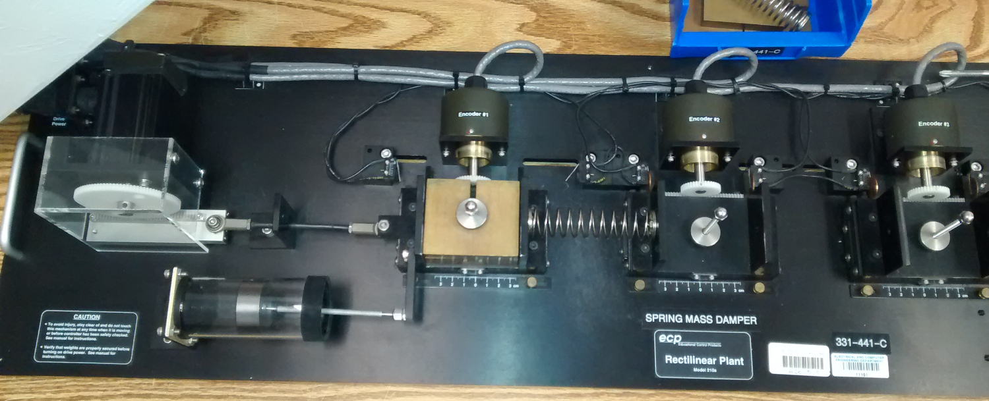
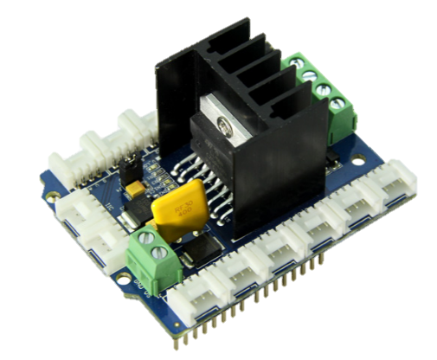
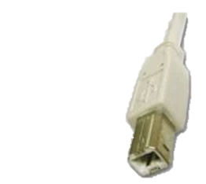
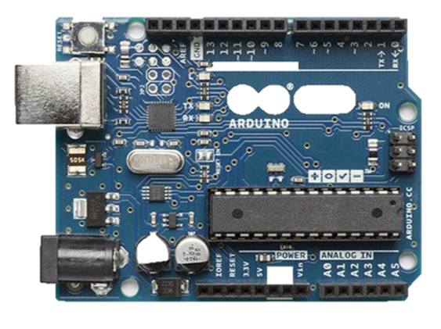
Current State
Mass Spring Damper
Control Electronics
Analog voltage
Computer (XP machine)
Encoder outputs
Proposed Future State
DC Motor driver “shield”
Analog voltage
Mass Spring Damper
PWM voltage command
Arduino Microcontroller
USB PC Interface
Reference, position readout
Encoder outputs

Slide 3
Proposed control scheme
Digital Controller
G(s)?
Analog Plant
+
Digital Controller (Arduino)
Digital to Analog Power Control (PWM)
DC Motor
Mass Spring Damper
Optical Encoder
“Sample and Hold” Position from optical encoder (Arduino)
Reference Input (USB)
Σ
v (n)
v (t)
τ(t)
x(t)
-
ZOH equivalent
C(z)
x(n)
Position Readout (USB)

Slide 4
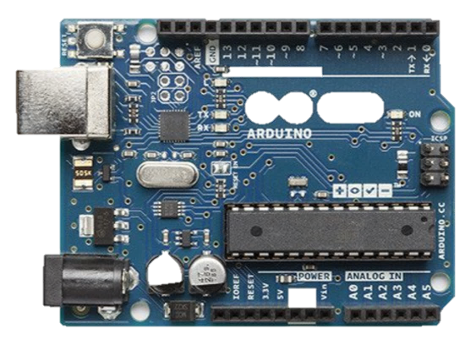

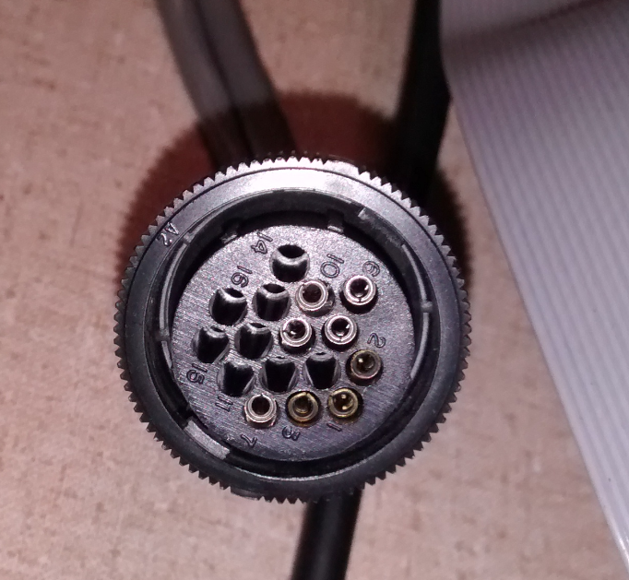

Hardware Needed
2x 16-pin circular connectors
Arduino Uno
Hardware enclosure, wiring, etc.
Seeed studio motor shield
Most of the hardware work will be wiring, soldering, integration, debugging

Slide 5
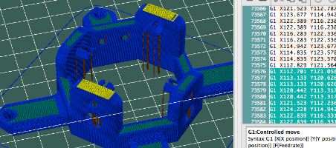
Software Needed
USB Interface
PC Terminal
Arduino Code
Plan to use open-source G-CODE interface used on RepRap 3d printers. Arduino module for this terminal exists, but may have to be adapted to fit into the rest of my Arduino code.
Existing 3d printer software will allow sending of G-CODE commands, but not data capture and plotting. This may be deferred for a future project to try to keep the scope manageable
The majority of the project will be writing a C++ program to do the following tasks at a particular sample rate:
Count pulses from optical encoder and translate into distance
Keep track of distance vs reference input, subtract these to produce error signal.
Apply recursive difference equation on error signal using pre-programmed coefficients to generate commanded output to motor
Update PWM duty cycle for motor shield output
A simple example
A simple PID controller will be used to prove the system. I will generate a ZOH equivalent of the mass spring damper and motor system, and design controller coefficients using techniques from class.
P I D
I will develop these two pieces as part of this project

Slide 6
Risks, Assumptions, and Other Concerns
PWM output from Arduino may not generate linear torque response on motor
May need to generate a lookup table to translate between PWM duty cycle and expected motor torque.
Will be able to connect to Mass-Spring-Damper hardware with an Arduino
I have DC motors and potentiometers at home to complete the project if I can’t figure out how to connect to the Mass Spring Damper hardware in the ECE lab
Using open source software as part of project
I will segregate any open source code into a “libraries” folder identified by a readme file as not my own work.
I will include a header identifying myself as the author for the source code that is my own work.

